Slide 1

Competitive Programming From Problem 2 Solution in O(1)
P
T
H
I
N
K
F
A
S
T
S
C++: Homework– 1D Arrays - 1
Mostafa Saad Ibrahim
PhD Student @ Simon Fraser University

Slide 2
Remember..The Practice
Learn little, Practice MUCH
Never keep reading in something that need practice
Your mind will be fluent in a new lanugauge AFTER threshold of practice amount

Slide 3
Homework: ConvertToInt
Given a string, Convert it to int
E.g. Convert(“156”) => 156
E.g. Convert(“001520”) => 1520
If the function received something wrong, assert with false

Slide 4
Homework: Grouping
Given a string, divide it to consective groups of same value
E.g input: 111222aabbb#
=> 111 222 aa bbb #
E.g. Input HHHH
=> HHHH (just 1 group)

Slide 5
Homework: Less than
Given 2 strings, check if first less than 2nd or not USING loops
E.g. “aa”< “aaaaaaa”
E.g. “ab” < “ca”
You could test your program using < operator

Slide 6
Homework: Substrings
Given a string, print all its sub-strings
E.g. Input 123a
1, 12, 123, 123a
2, 23, 23a
3, 3a
a

Slide 7
Homework: Add 9999
Given a very long string of digits, add 9999 to it
string add9999 (string num)
E.g. Given “129” => “10128”
E.g. Given “123456” => “133455”
E.g. Given “123456789123456789123456”
=> 123456789123456789133455

Slide 8
Homework: Sum Query
Given an array and many queries
Each query (start index, end index)
Return sum of this interval
E.g. Array: 1 2 5 0 4
Query(0, 1) = 3 => sum of 1+2
Query(0, 4) = 12 => Whole array sum
Query(2, 4) = 9
We can code that easily, but not efficiently
HOW to answer the query with NO loops
Hint: Accumulate array: e.g. => 1 3 8 8 12

Slide 9
Homework: Search for number
Given an array and value F, check if the value exist in the array or not.
Now, what if the array sorted how to do faster?
Hint: If a book is 3000 pags. You need page 1000. Then you got some random location, say 2000. You need to search in first block (1-1999), not second block (2001, 3000)

Slide 10
Homework: Find S=2 numbers
Given an array and value S, check if the there are 2 numbers in the array with sum S.
Now, what if the array sorted how to do faster?
Hint: You can use the fast solution in previous problem
Hint: You can do better.

Slide 11
Homework: Big Factorial
Long long is only 64 bit. It is limited in what it can represent. We can represent 10! NOT 100!
What if we want factorial 100?
Simulate it using a big array

Slide 12
Homework: Big Factorial - Hints
Create a big array. Intialize it to 1
Think in it as reversed array. Arr[0] first digit
From i = 2 to N
Multiply i in every cell
For every cell, if its value > 9handle its carry (v%10, v/10)
For last cell, check if it has carry (typically will have), and put it in next cell, AS LONG AS there is a carry

Slide 13
Homework: Big Factorial - Hints
1 | 0 | 0 | 0 | 0 | 0 | 0 | 0 | 0 | 0
Initalize 1 = 1!
2 | 0 | 0 | 0 | 0 | 0 | 0 | 0 | 0 | 0
Multiply 2 = 2!
6 | 0 | 0 | 0 | 0 | 0 | 0 | 0 | 0 | 0
Multiply 3 = 3!
24 | 0 | 0 | 0 | 0 | 0 | 0 | 0 | 0 | 0
Multiply 4
Remember...Keep only a digit in cell...move carry to next cell
4 | 2 | 0 | 0 | 0 | 0 | 0 | 0 | 0 | 0
4! But REVERSED
20 | 10 | 0 | 0 | 0 | 0 | 0 | 0 | 0 | 0
Multiply 5
0 | 12 | 0 | 0 | 0 | 0 | 0 | 0 | 0 | 0
Move Carry 1st cell
0 | 2 | 1 | 0 | 0 | 0 | 0 | 0 | 0 | 0
Move Carry 2nd cell = 5!
Be careful from last cell...we may keep shift carry to right many times when N is large

Slide 14
Homework: Find Primes
Sieve Algorithm suggesst a nice way to get all primes within arrange.
Say we want to get primes in range 25
Which are: 2, 3, 5, 7, 11, 13, 17, 19, 23
Step 1: Create array boolean of length 25
Set arr[0] = arr[1] = false
From i = 2 to N: if arr[i] = true
For each arr[j] = true IF(j % i == 0)
Set arr[j] = false

Slide 15
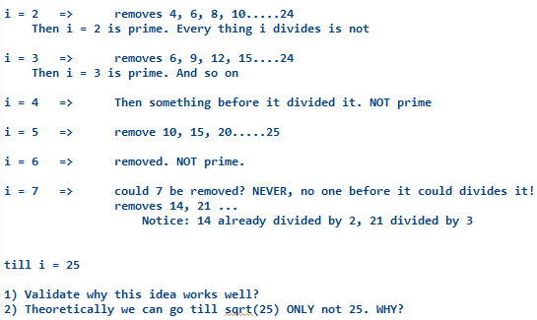
Homework: Find Primes-Simulate

Slide 16
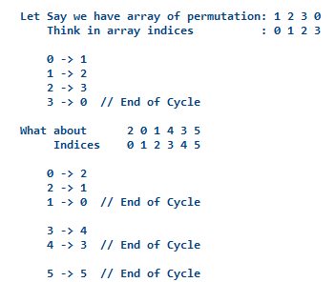
Homework: Permutation Cycle
void printCycles(int arr[], int SIZE)
{
=>
}

Slide 17
Homework: Josephus problem
Given N and K
We have a group of N people in Circle
They are numbered 1 2...N
Someone has gun..start from 1
Count K persons, and Kill Kth person
He keep doing so, till last one. This is survivor
Find it
int solveJoseph(int n, int k)

Slide 18
Homework: Josephus problem - simulate
Let N = 7 and K = 3
1 2 3 4 5 6 7
First time, count 1, 2, 3 and kill 3
1 2 4 5 6 7 (now gun on 4)
Count 4, 5, 6 and kill 6
1 2 4 5 7 (gun on 7)
Count 7 1 2 and kill 2 (remember it is circle)
1 4 5 7 => 1 4 5 => 14 => 4
4 is survivor

Slide 19
So
Start to Practice...Try each problem
Assign sometime to think, code and debug
Never put much time in one idea/problem
If failed to get idea after 40 minute, start to ask. If failed to code it within 40 min, see others code
Code all of them, even if you think you know it
Then, think how to code it better / shorter

Slide 20
Posting Solutions
Feel free to post your solution either they are right to help others...or wrong and need help.
If I have time, I may check what is wrong.
Use https://ideone.com/ to post link of code (or similar ones)

Slide 21
تم بحمد الله
علمكم الله ما ينفعكم
ونفعكم بما تعلمتم
وزادكم علماً

